Slide 1

SAP Datasphere Training – Day 5
www.anubhavtrainings.com

Slide 2
Agenda
Data Flow - Introduction
01
Data flow introduction for scripted replication.
Get started with Standard roles and Data Builder.
Python Introduction
02
Introduction to Python programming
www.anubhavtrainings.com
Task Chain
03
Task chain to group actions and perform multiple tasks.
SQL Scripting
04
SQL programming language for more advanced business logic.

Slide 3
Data Flow - Introduction
Data flow allows us to perform ETL in SAP Datasphere. ETL – Extract Transform and Load
We can create a graphical flow of data where we have multiple sources to bring data (local/remote), perform transformation, munging, wrangling and store in a single target.
Data integration from variety of data sources
Easy to use data flow modeling experience for ETL requirement
Load and combine data from different sources SAP and Non SAP
Use standard transformation capabilities (low code) and advance scripting capability (high code)
Apply a generic filter-based delta or select specific column to reduce amount of data which transfers from source.
Dynamic memory allocation and auto restart
Bring the Employee and its address data from SAP HANA Cloud in SAP Datasphere, in order to keep DPP law in place, since user has not provided the consent, we cannot store their email and phone no. When we bring this data we need to mask it.

Slide 4







FORMULA’S used
EMPLOYEENAME
CONCAT(CONCAT("NAME_INITIALS","NAME_FIRST"),"NAME_LAST")
PHONENUMBER
CONCAT('XXXXX-XXXX-',RIGHT("PHONENUMBER",4))
EMAILADDRESS
CONCAT(CONCAT(LEFT("EMAILADDRESS",4),'XXXX'),RIGHT("EMAILADDRESS",4))

Slide 5
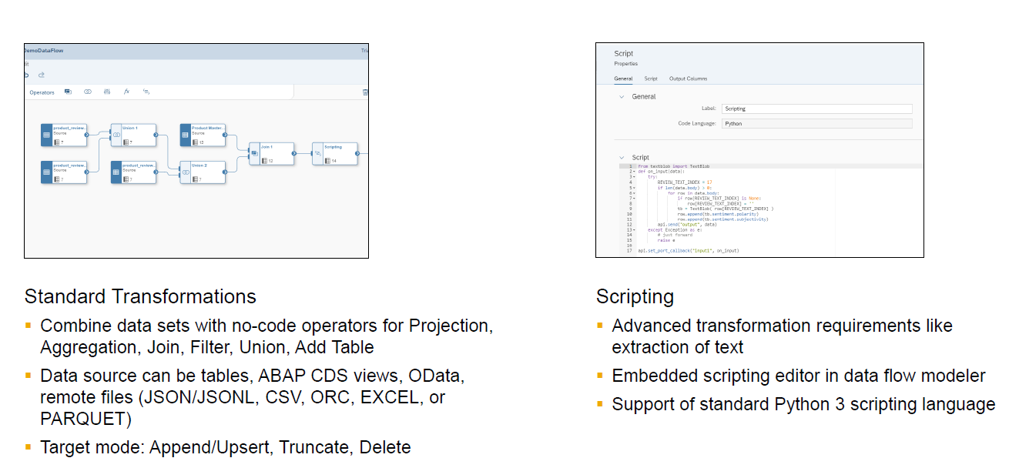
Script operator in data flows

Slide 6
Introduction to Python
Python is a high-level, general purpose programming language. Its design philosophy emphasizes code readability with the use of significant indentation via the off-side rule. It is heavily used for data science projects have the capability for data transformation and cleansing.
We use Microsoft VS Code tool (lifetime free) to practice python
https://code.visualstudio.com/download
Install python in your computer
https://www.python.org/
Go to windows Environment variables and under Path add entry for python
C:\Users\<user>\AppData\Local\Programs\Python\Python311\Scripts
C:\Users\<user>\AppData\Local\Programs\Python\Python311\
Create a folder in your laptop where we store all python code and open folder.. In vs code
Install the python Extension in VS Code
https://docs.python.org/3/library/index.html
https://www.w3schools.com/jsref/jsref_obj_regexp.asp

Slide 7
Introduction to Pandas
Pandas is a fast, poweful, flexible and easy to use open source data analysis and manipulation tool built on top of python programming language. It is used in data science. Data science is a field of engineering which deals with massive data focusing on analysis of data points and get meaningful answers. Pandas is a module which makes data science very easy.
Use case:
I have a simple dataset of temperature data from usa cities. I want to know in this dataset
What was max temperature in the month of jan
On which day(s) it rain
What was the average speed of winds
pip install pandas
Data frames are the main data objects in pandas, they represent 2 dimensional data (table). They have rows and columns, makes our life easy to traverse and manipulate data directly w/o loop.

Slide 8
Code by Anubhav
data["email"] = data["first_name"] + "." + data["last_name"] + "@anubhav.com“
Use case:
We have flight tables present in our SAP HANA cloud system, we want to bring data from hana cloud for the flights and their price. When we bring the Amount for flight ticket we need to a GST
AA → 18% LH → 12% other → 0%
Also we need all dates stored in YYYY-MM-DD format in datasphere.
def change_price(row): if row['CARRID'] == 'AA': return float(row['FORCURAM']) * 1.18 elif row['CARRID'] == 'LH': return float(row['FORCURAM']) * 1.12 else: return float(row['FORCURAM']) #Loop over the data frame record by record and calculate final taxed price data['FORCURAMNEW'] = data.apply(change_price, axis=1) data['FLDATENEW'] = pd.to_datetime(data['FLDATE'], format='%Y%m%d', errors='ignore') data.dropna(how='all')

Slide 9
Task Chain
A task chain allows grouping of multiple tasks in a chain of actions and run them manually once, or periodically, through a schedule. We can create linear task chains in which one task is run after another OR we can create task chain in which individual tasks are run in parallel and successful continuation of the entire task chain depends on whether ANY or ALL parallel tasks are completed successfully. In addition, when creating or editing a task chain, we can also setup email notification for deployed task chain to notifyselected users of a task chain for completion.
Linear task chain allow us to define a group or series of tasks executed one after another.

Slide 10
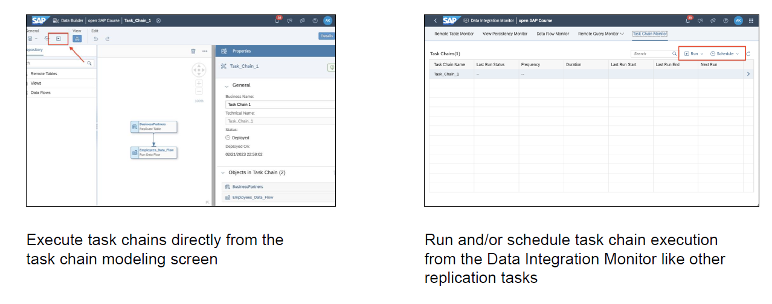
Task Chain - Execution type

Slide 11
View persistency
Improve performance while working with views using the persistence/materializing view data, and schedule regular updates to keep data up to data. Generally, when a view executes (virtual table), they perform complex queries behind the scenes to fetch data from underlaying tables, at times if we use such views in SAP Analytics cloud, our report performance might be slow, one way to improve is materialize the view.
Replication table/ View persist – Perform Snapshot to update data or Run Task chain

Slide 12
EPM Data Model
Master Data
Customers and Suppliers – Business Partners
Products and Product texts
Transaction Data
Sales orders, Sales Order Items
Purchase orders, Purchase order items
Invoices, invoice items
ITeIO
Selling electronic goods online like Amazon
Sales Order
SoldTo, ShipTo
Sales Order Items
Laptop 2
Pen Drive 1
HDD 5
Customers
Suppliers
Invoice
SoldTo, ShipTo
Invoice Items
Laptop 2
Pen Drive 1
HDD 5
stock

Slide 13


SQL Views
In case the consultants not like coding they can go for graphical views, graphical views are used for simple use cases with no coding requirement. We use joins and unions etc to work with Graphical views. If our requirement is to develop a more complex view where we take full control of the view processing logic with SQL coding, we can opt for SQL view.
With this option we can create a view to query source in a powerful SQL editor. We can choose between writing a SQL standard query using SELECT statement and operators such as JOIN and UNION, or use SQL Script to produce table function. We can drag and drop from source browser later on this view in data flows or other views/models.
https://help.sap.com/docs/HANA_SERVICE_CF/7c78579ce9b14a669c1f3295b0d8ca16/1a116cbd04a942e498ffef3a37b47461.html

Slide 14
SELECT "PARTNERID", SUM("GROSSAMOUNT") AS SALES_AMOUNT, COUNT("SALESORDERID") AS NO_OF_ORDERS, RANK() OVER (ORDER BY SUM("GROSSAMOUNT") DESC) AS RANK_ORDER, DENSE_RANK() OVER (ORDER BY SUM("GROSSAMOUNT") DESC) AS DENSE_RANKFROM "SalesOrders"GROUP BY "PARTNERID"

Slide 15
Common challenges in connecting
Run the SAC and DS in a same browser and same browser multiple tab
Your User ID: GE50873
Your User ID: GE50874
Please make sure that you register SAC and DS from same place
https://developers.sap.com/tutorials/sac-guidedexperiences-getstarted.html
3. Create connection with same name as the user id of the sap datasphere
4. Always use optimized design experience in SAC

Slide 16
SQL Script
SQL script is an extension of SQL and provides programming capabilities with SQL. With just SQL we can retrieve the data but data manipulation and chaining is not possible. SQL script is according to database, since DS usages HANA database, we need to code SQL Script as per HANA standard
https://help.sap.com/docs/SAP_HANA_PLATFORM?locale=en-US&task=use_task
Data Flow graph / Declarative logic Imperative logic/Orchestration logic
Back-to-back SQL statements - Both Declarative and code
High chance of getting executed in parallel by HANA - No parallelization
Best for performance - allows complex logic building
Used for simple use cases - complex cases with IF and loops
Chain SQL statements - Create variables and work with them

Slide 17
Example
END
--Q1
lt_prod = SELECT pid FROM prod WHERE type = ‘Laptop’;
--Q2
Lt_sales = SELECT ordid FROM orders
WHERE prodId = SELECT pid FROM :lt_prod;
--Q3
Lt_purc = SELECT ordid FROM purchase
WHERE prodId = SELECT pid FROM :lt_prod;
--Q4
Select sum(sales) from :lt_sales;
Q4
Q2
Q3
HANA will come out of parallel mode
If we use DECLARE statement to create variable
Any query not assigned to a implicit variable
We use any DML and DDL statement
Q1

Slide 18
Rules to follow
Every statement must ends with Semi Colon
It is not case sensitive
If you create a variable and do not assign any value to it, NULL gets assigned and any operation with NULL becomes NULL
We use DECLARE statement to create variables
If you create a variable we use := as assignment operator, = as comparison operator
When we want to use a variable value we use value of (:) operator declare x integer; :x
Always try to use queries on top before imperative logic starts so that you can stay in parallel mode maximum time
There are 3 types of variables in SQL Script
Scalar variable – hold single value DECLARE varname type;
Array variable – hold multiple values of same data types DECLARE arrname type ARRAY;
Table variable – hold many columns and many rows like internal table in ABAP, perfect for
Data manipulation, created using DECLARE statement (explicit), Implicit declaration

Slide 19
Containers in SQL Script
Anonymous block
Procedure
Function – Scalar and Table
Use case:
Input will be country code
- fetch all business partners for that country
- loop at each business partner one by one
- Get all the orders of each bp one by one
- Adding these orders to a final table which shows total sales per bp

Slide 20
Final code
--declaring variablesDECLARE lv_rc int;DECLARE lv_bpid nvarchar(40);DECLARE lv_country nvarchar(40);DECLARE lv_company NVARCHAR(40);--explicit table variableDECLARE lt_collect TABLE(PARTNERID varchar(30), COMPANYNAME varchar(80), GROSSAMOUNT DECIMAL(10,2), CURRENCYCODE varchar(4), COUNTRY varchar(20));--ALL processing will now be done here--implicit tablelt_bp = select bpa.partnerid, bpa.companyname, addr.countryfrom "BusinessPartners" as bpa inner join "Addresses" as addron bpa."ADDRESSID" = addr."ADDRESSID" where addr."COUNTRY" = :ICTRY;--Loop at each record of input tableFOR lv_rc IN 1..record_count(:lt_bp) DO lv_bpid = :lt_bp.partnerid[:lv_rc]; lv_country = :lt_bp.country[:lv_rc]; lv_company = :lt_bp.companyname[:lv_rc]; lt_so = select :lv_bpid as partnerid, :lv_company as companyname, grossamount, currency as currencycode, :lv_country as country from "SalesOrders" where partnerid = :lv_bpid; lt_collect = select * from :lt_so union all select * from :lt_collect; END FOR;RETURN SELECT * FROM :lt_collect;

Slide 21

What We Did
Let’s Summarize

Slide 22
www.anubhavtrainings.com
Thank You
End of Day 5

Slide 23


We’re committed to empower you to be
#FutureReady
through powerful training solutions.
We build the workforce of the future.
250+
Corporate Clients
30,000+
Learners Trained
25000+
Learners Placed
FREE WEBINARS
Sign up for free webinars with industry experts every fortnight!
Enroll Now!
Contact us today!
https://anubhavtrainings.com

